Slide 1
Social and semantic recommendation system : communities-based approach
GUILLOU Frederic

Slide 2
Outline
Introduction
Motivations
The basic recommendation system
First phase : semantic similarities
Second phase : communities
Application on data
Implementation

Slide 3
Introduction
The social network analysis is defined as the study of social entities (people in organisations called actors), as well as the study of interactions and links/relations.
Various studies can be done on a social network :
Properties of structure and its role
Position and prestige of each social actor
Research of different kinds of subgraphs, for example communities made by groups of actors which have same interests.
The social network can also be a resource to create a recommendation system : find an expert in specific area, suggest products for selling, recommend to a friend, etc

Slide 4
Introduction
Recommendation systems are a part of information filtering system that seek to predict the 'rating' or 'preference' that a user would give to an item or social element they had not yet considered
They use either a model built from the characteristics of an item (content-based approaches) or the user's social environment (collaborative filtering approaches)
Recommender systems have become extremely common in recent years (example : recommendation of products in Amazon.com)

Slide 5
Motivations
Improve a recommendation system in two phases :
1) Using semantic similarities
2)Using graph theory to detect communities

Slide 6
The basic recommendation system
The recommendation depends on :
The similarity of users’ preferences and the submitted request
The betweenness centrality measure of user nodes which are on path of the solution on the other side.
To make a research on the graph, the best spanning tree is found and explored

Slide 7
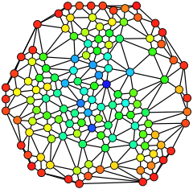
The basic recommendation system
Betweenness measure : measure of a node's centrality in a network equal to the number of shortest paths from all vertices to all others that pass through that node.
Computed as follow for a vertex:
For each pair of vertices, compute the shortest paths between them.
For each pair of vertices, determine the fraction of shortest paths that pass through the vertex in question
Sum this fraction over all pairs of vertices

Slide 8
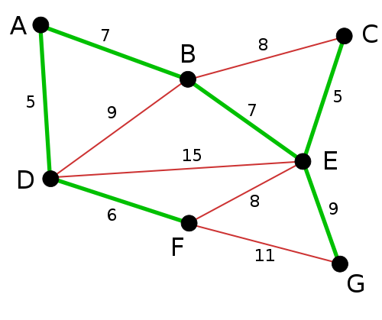
The basic recommendation system
Spanning tree : Given a connected undirected graph, a spanning tree of that graph is a subgraph that is a tree and connects all the vertices together
The maximum spanning tree is found with Kruskal's algorithm.

Slide 9
The basic recommendation system
The process is as follow :
Compute the maximum spanning tree
Compute and store the betweenness of all the nodes.
Extract from the spanning tree the best similar buyer using the A* algorithm

Slide 10
First phase : semantic similarities
Semantic similarities is a concept whereby a set of terms within term lists are assigned a metric based on the likeness of their meaning / semantic content
Integrate in the recommendation system a similarity measures library or relevance measures in order to improve quality of recommendation results

Slide 11
First phase : semantic similarities
These measures will be of various nature :
Some will be basic measures
Others will have semantic or structural dimension taking in consideration the knowledge of the domain represented as an ontology, or behaviour ressemblance between actors
All these measures have to be studied and a test plan has to be made, in order to report the quality of recommendation results depending on these various measures

Slide 12
Second phase : Communities
What is a community ?
Community structure refers to the occurrence of groups of nodes in a network that are more densely connected internally than with the rest of the network.
This inhomogeneity of connections suggests that the network has certain natural divisions within it.
Communities are often defined in terms of the partition of the set of vertices : each node is put into one and only one community.

Slide 13
Second phase : Communities
How are we going to use communities ?
A study of communities detection algorithms in social networks has to be made in order to improve perfomances of the recommendation system
Several recommenders will be launched at the same time in each community
Results will be compared with basic system in terms of precision (the probability that a selected item is relevant) and recall (the probability that a relevant item will be selected)

Slide 14
Second phase : Communities
How to detect communities ?
Several methods have been developed and employed with varying levels of success
Among these methods :
Minimum-cut method
Hierarchical clustering
Girvan–Newman algorithm
Modularity maximization
The Louvain method
Clique based methods

Slide 15
Second phase : Communities
How to detect communities ?
Focus on the Louvain method, one the most widely used method:
Modularity is a benefit function that measures the quality of a particular division of a network into communities
First, this method looks for "small" communities by optimizing modularity in a local way
Second, it aggregates nodes of the same community and builds a new network whose nodes are the communities
→These steps are repeated iteratively until a maximum of modularity is attained

Slide 16

Application on data
Data collected in summer 2006 by crawling Amazon website
Contains product metadata and review information about 548,552 different products (Books, music CDs, DVDs and VHS video tapes).
For each product the following information is available:
Title
Salesrank
List of similar products (that get co-purchased with the current product)
Detailed product categorization
Product reviews: time, customer, rating, number of votes, number of people that found the review helpful

Slide 17
Implementation : main process
The programming language used is Python
Steps :
Extraction of the collaboration network (nodes are users ) from Amazon data and elaboration of the basic and semantic preferences for each user
Add similarity measures and test/compare results of recommendation system with these new measures
Find communities using Gephi or Python libraries (networkx)
Apply some process on the graph or communities to obtain significative communities only
Separate communities graph out and apply recommendation system to each
Examine results on each community and aggregate results to compare with basic results

Slide 18
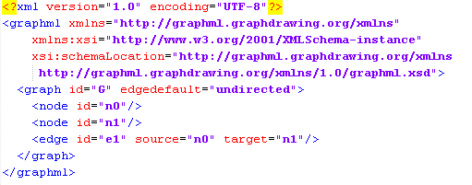
Implementation : GraphML
Comprehensive and easy-to-use file format for graphs, based on XML
Language core to describe the structural properties of a graph and flexible extension mechanism to add application-specific data.
Main features :
Directed, undirected, and mixed graphs,
Hyper graphs,
Hierarchical graphs
Graphical representations
References to external data
Application-specific attribute data
Light-weight parsers

Slide 19

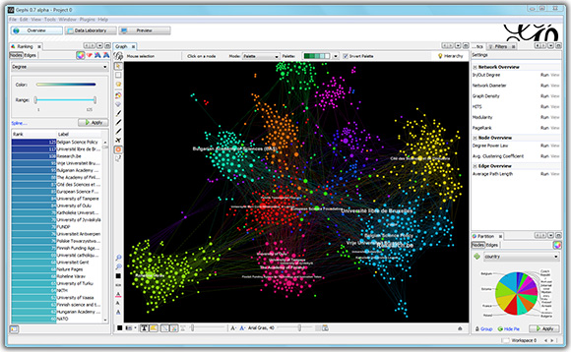
Implementation : Gephi
Gephi is an open-source network visualization platform.
Created with the idea to be the Photoshop of network visualization
Combines a rich set of built-in functionalities and a friendly user interface aggregated around the visualization window.

Slide 20
Implementation
Work done :
Extraction of the collaboration network (nodes are users ) from Amazon data and elaboration of the basic and semantic preferences for each user
Issues :
Memory : with 2000 products -> 17000 nodes in graph users
Time for betweenness calculation
Current work :
Implementation of similarity measures

